Slide 1
DISEASE PREDICTION USING MACHINE LEARNING AND AWS
Purvi Jain Aditya Kiran
Sai Charith Govardhanam

Slide 2
Table of Content
Project Implementation
Project Definition
Project Architecture

Slide 3
Project Definition

Slide 4
Scope of the Project: To build a machine learning model that can predict a patient's disease based on their symptoms and deploy the model on AWS to build a website that allows users to input their symptoms and get a disease prediction. The project aims to improve healthcare by providing an accessible and accurate tool for disease diagnosis.

Slide 5
Data Overview
The dataset contains 4920 rows and 18 columns.
The target variable is the column "prognosis", diagnosis of the patient.
which indicates the
The remaining 17 columns are the features, which include various symptoms and other relevant information.
Each row represents the medical history of a patient, with each column containing information about a particular symptom or feature.
The symptoms are represented using binary values (0 or 1), indicating the presence or absence of the symptom.
The dataset contains records for 41 different diseases, which are the possible values of the "prognosis" column.
Some of the diseases in the dataset include Dengue, Malaria, Hepatitis B, Hypertension, and Diabetes.

Slide 6
Expected Outcomes
The machine learning model can be trained and deployed using the Kaggle Notebook and saved as a pickle file.
The website should be an integrated pickle file with flask.
The website should be hosted on Amazon Web Services (AWS), which offers scalable and reliable cloud infrastructure for web applications.
A website that allows users to select their symptoms and receive a predicted diagnosis based on the machine learning model trained on the dataset.

Slide 7
Project Architecture

Slide 8
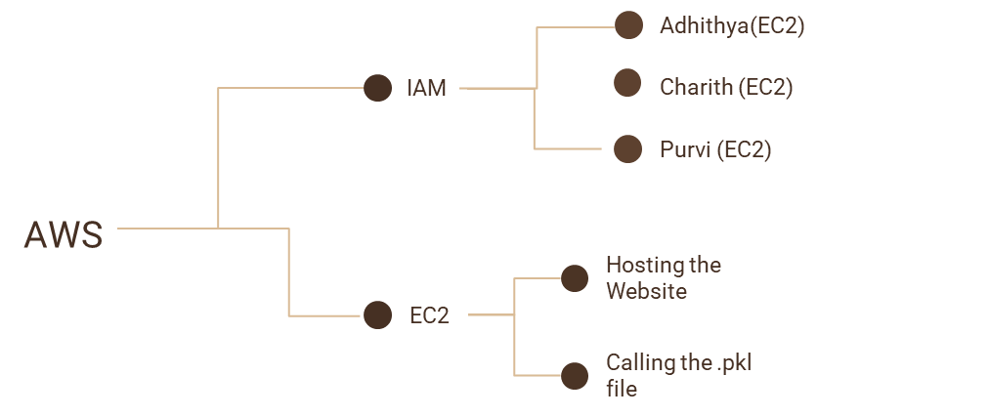
Architecture of the Project

Slide 9



Data Flow
Model Generation Using Pickle
Google Colab
UI
using Flask
Kaggle
EC2

Slide 10
Project Implementation

Slide 11
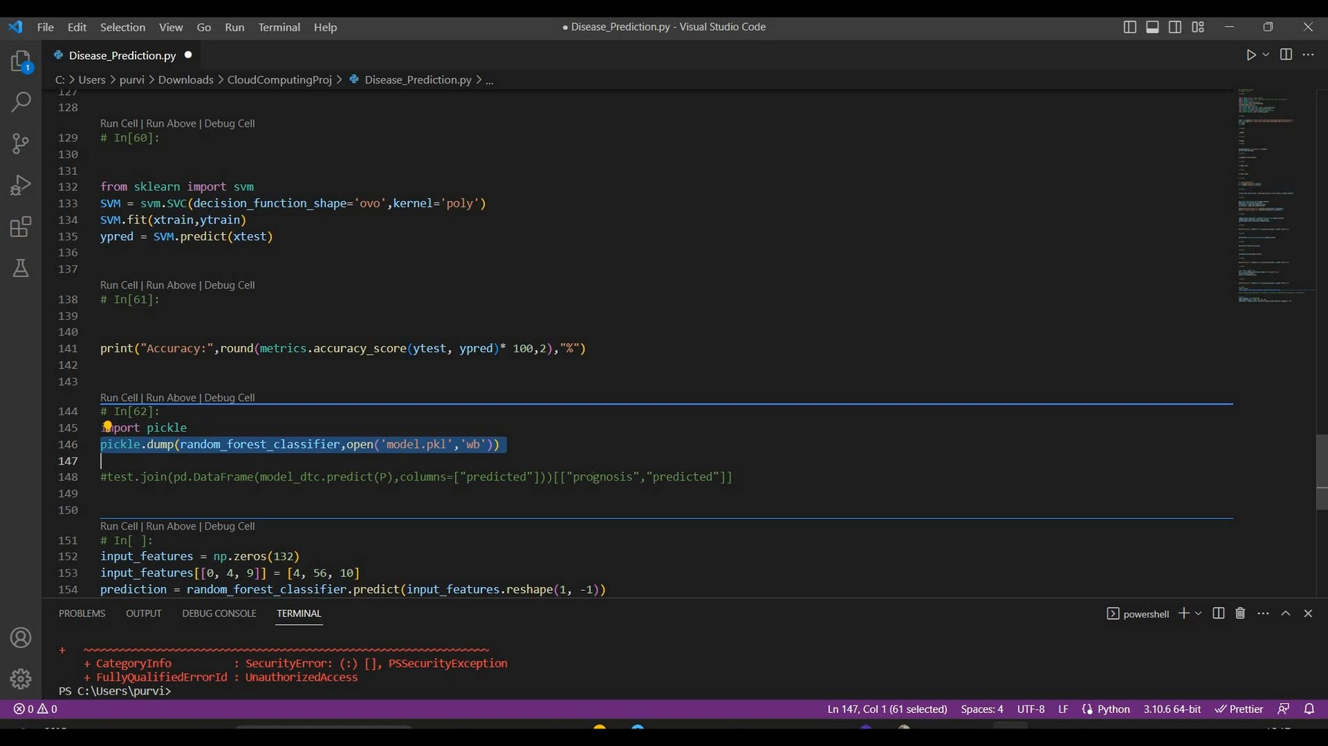
Generating the pickle file

Slide 12
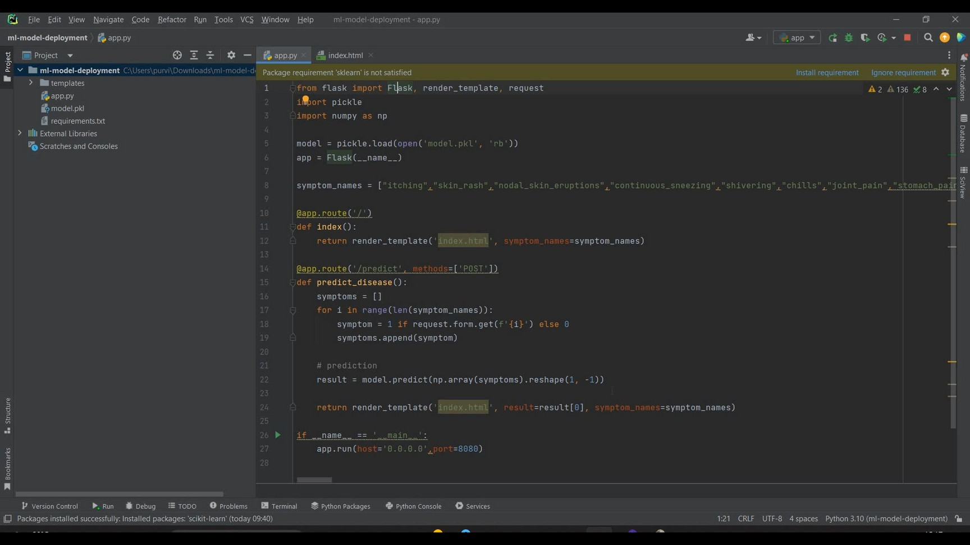
Generating a website using Flask

Slide 13
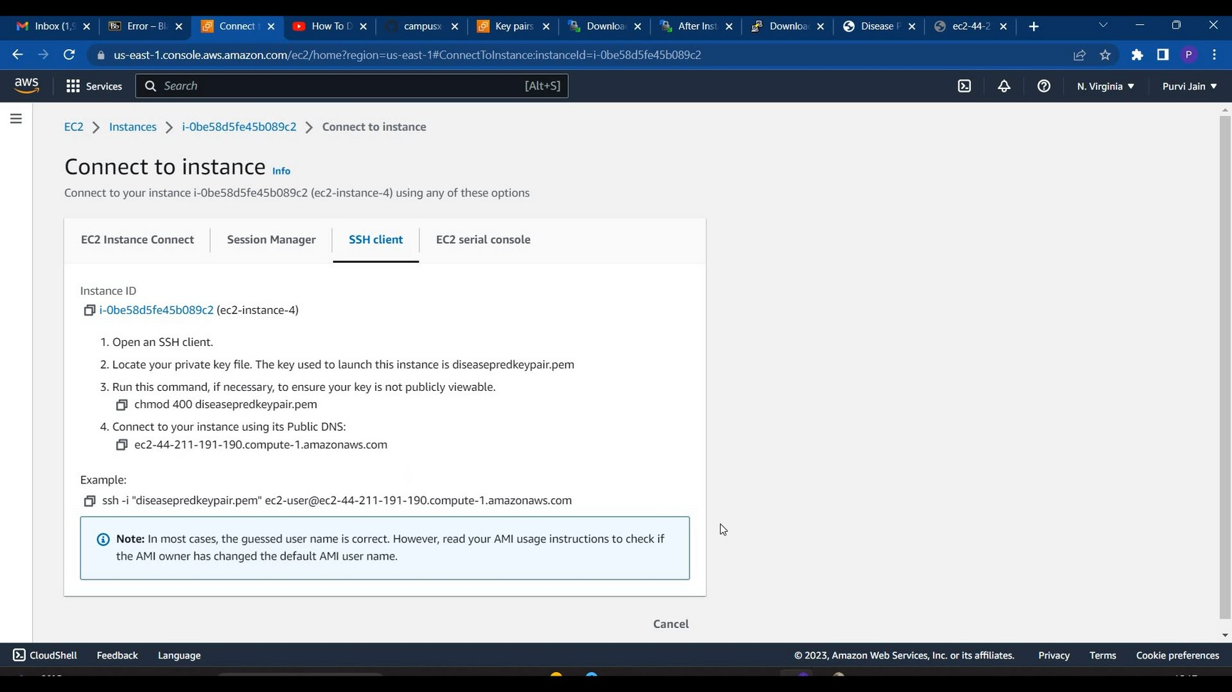
Connect to an instance

Slide 14
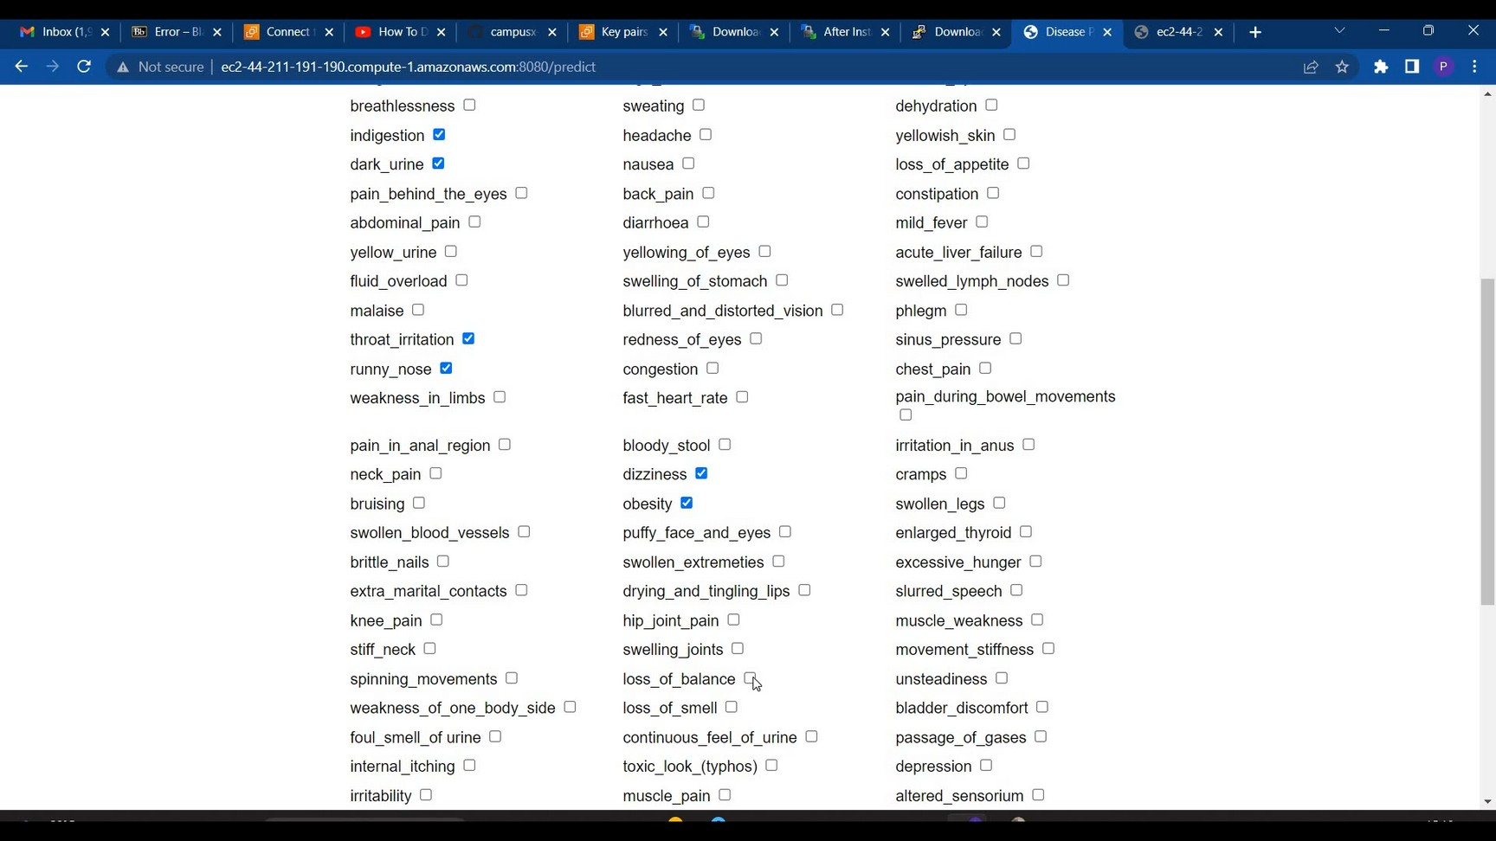
Selecting the features

Slide 15
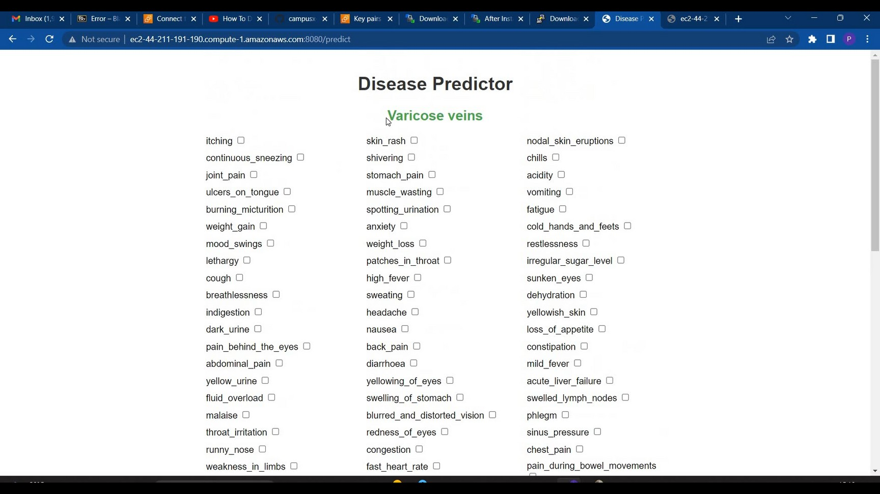
Predicting the disease

Slide 16


